Slide 1
Software

Slide 2
Software
Computers require two types of software
  Applications software ;
    such as word processing, spreadsheet or graphics packages
  Operating systems software :
    to control and monitor the running of application programs, and allow users to communicate with the computer

Slide 3
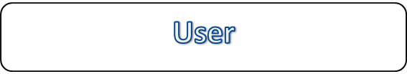

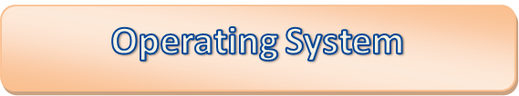
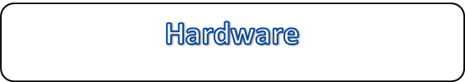
The Operating System serves as an interface between the application programs and the hardware

Slide 4
Functions of an operating system
Memory management.
Resource allocation and scheduling
Backing store management
Interrupt handling
Allowing a user to communicate with the computer

Slide 5
User interface (Shell)
Device Management
File Management
Memory Management
Processor Management

Slide 6
Utility programs
As well as the basic operating system, the systems software available to users includes numerous utility programs, such as:
  Virus checkers - check disks and memory for viruses and delete them if detected;
  Security and accounting software - checks user IDs and passwords, counts and reports the number of attempts made to log on under each user ID, the amount of processor time used at each session, total login time and so on;

Slide 7
Utility programs (continued)
  File management utilities - attempt to repair corrupted files, reorganise files on disk so that free space is ‘defragmented’, ‘zip’ (compress) files so that they occupy less space.

Slide 8
DOS (Disk Operating System)
  tells the computer how to format, read and write information on disk (either floppy or hard)
  manages peripheral devices such as printer and keyboard
  controls the execution of application software
  Also specifies
    how many files can be held in a disk directory
    what is an acceptable file or directory name
    the number of bytes that can be on a disk
    the amount of memory usable by a program

Slide 9
The components of a typical microcomputer operating system
Resident Operating System
System constants and Parameters
Interrupt handler routines
Command Processor
System disk
Input/output control System
File System
Printer
Transient area
Gail Walters

Slide 10
Systems software
Operating system
Utility programs
  perform common useful tasks such as search for lost files, sort files of data into a particular sequence, copy disk files to magnetic tape for backup purposes and so on.
Programming language compilers/interpreters
  are different types of program used to translate the statements in a programming language such as Pascal, Visual Basic or C into a form that the computer can understand.

Slide 11
Systems software (continued)
Performance monitoring software
  is used to monitor, analyse and report on the performance of a computer and its components. It can provide information such as the overall utilisation of the processor and number of disk accesses over a given period of time.
Communications software
  In a mainframe environment, this is executed on a separate, dedicated processor (‘front-end processor’) and controls the flow of data to and from remote locations.

Slide 12
Applications software
Written to perform specific tasks
  such as order entry, payroll, stock control or hospital appointments
May be designed specifically for a company
  (‘bespoke software’) and written especially for them using a programming language or software such as a database management system
Alternatively, the software may be purchased ‘off the shelf’

Slide 13
Memory
Physical Memory Devices
A computer’s memory hold binary digits, or Bits.
When you read memory, you extract the contents but do not change them
When you write memory, you record new values and thus “destroy” the old content.

Slide 14
Addressing Memory
Memory capacity is typically measured in Megabytes
To distinguish them, each byte is assigned a unique address
The processor accesses a specific memory location by referencing its address

Slide 15
Group Activity:
In groups of three:
Identify as many input and output devices as you can. List their advantages and potential uses.

